Slide 1
Outcome Predictor
Brittany Roberts

Slide 2
Introduction
The app follows the Logistic Regression model created to predict whether a patient will have a positive or negative outcome based on symptoms and diagnosis.
Data was taken from here: Disease Dataset
The Dash app allows the user to input symptoms and diagnosis to get a prediction on patient outcome.

Slide 3
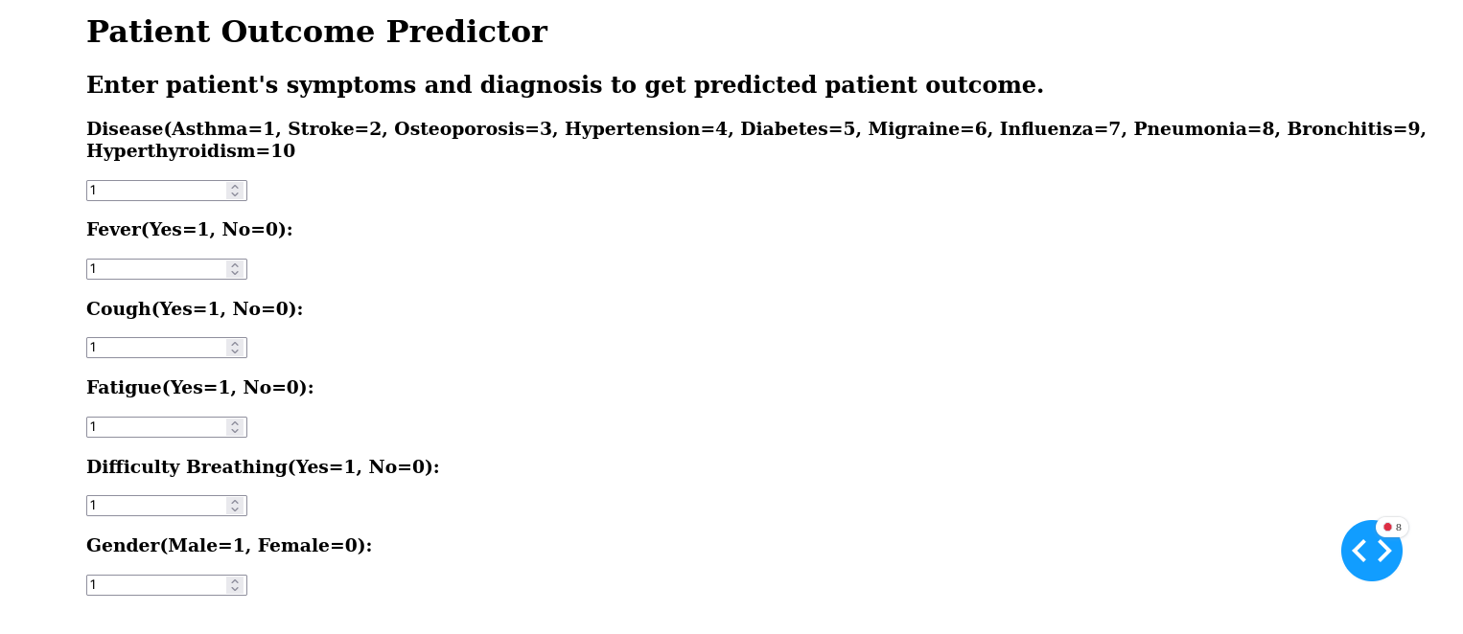

Slide 4
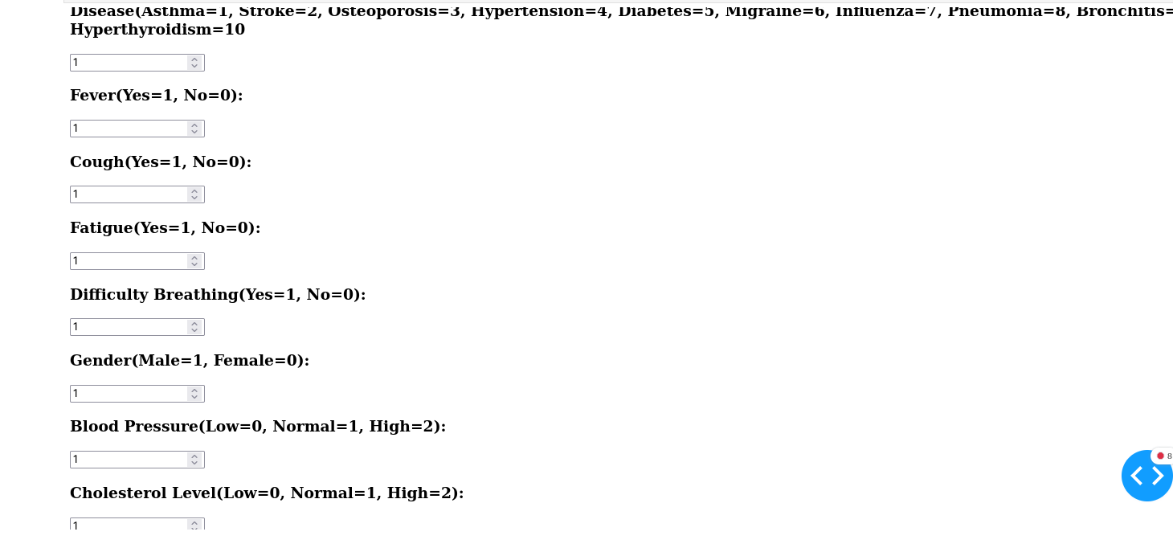

Slide 5
